Slide 1

Review 2 AI-POWERED HEALTH DIAGNOSTICS Project Category: RESEARCH
Guide Details: Student Details:
Dr. B. Arunsundar CH.S.K.Gowtham-RA221102701049 Assistant Professor S. Sai Charani-RA2211027010186 Department of DSBS

Slide 2
Abstract
This project is a research-based exploration of using machine learning for predicting diseases based on symptoms.
The goal is to find an accurate and reliable method to support early disease diagnosis using symptom data.
A dataset containing symptoms, disease names, and precautionary advice was used for model training and testing.
Various classification algorithms were evaluated, including Logistic Regression, Decision Tree, SVM, Naïve Bayes, and Random Forest.
After comparing results, the Random Forest algorithm performed best, achieving 89% accuracy and 92% precision.
This research contributes to the field of AI in healthcare, with the potential to support future systems for accessible and efficient diagnostics.

Slide 3
Introduction
The project is a research-based study focused on using machine learning for predicting diseases based on symptoms.
It explores how AI algorithms can assist in early disease detection without requiring clinical tests or physical checkups.
The system is trained using a dataset containing symptoms, disease labels, and precautionary measures.
Multiple machine learning models are tested and compared to find the most accurate one for symptom-based disease prediction.
The aim is to improve healthcare accessibility and enable faster, data-driven diagnosis in areas with limited medical resources.
This research can serve as a foundation for future development of intelligent health support tools and deeper medical AI studies.

Slide 4
Literature Survey
S. No | Title | Methodology | Identification of Gaps and Limitations
1 | Rajkomar, A. et al. (2018). Scalable and accurate deep learning with electronic health records, npj Digital Medicine, 1(1), 1–10. | - Implemented deep learning models on large-scale EHR datasets. - Used TensorFlow-based neural networks for disease prediction. - Emphasized scalability and transferability across institutions. | - Requires large, high-quality EHR data. - Limited interpretability. - High computational cost for real-time use.
2 | Sahithya, B. et al. (2024). Empowering Healthcare with AI, ICTA 2024. | - Focused on AI applications: medical imaging, EHR analysis, and chatbots. - Used various ML and DL frameworks across healthcare domains. - Integrated multi-source data for improved decision-making. | - Broad scope, lacks disease-specific insights. - Minimal focus on structured symptom-based disease prediction. - Limited evaluation metrics presented.
3 | Sayed, M. A. et al. (2023). Parkinson's Disease Detection through Vocal Biomarkers, arXiv:2311.05435. | - Analyzed voice data using ML algorithms for early Parkinson’s detection. - Extracted acoustic features and trained classifiers like SVM and XGBoost. | - Focused only on one disease. - Relies heavily on audio data availability and quality. - Not generalizable to other conditions.
4 | Gupta, I. et al. (2022). PCA-RF: Parkinson's Disease Prediction using Random Forest, arXiv:2203.11287. | - Applied PCA for dimensionality reduction and RF for classification. - Achieved high accuracy on Parkinson’s dataset. - Compared performance with other classifiers. | - Targeted a single disease. - Lacks symptom-level analysis. - No integration of patient demographics or precautions.
5 | Lee, J. et al. (2024). Explainable AI-Based Clinical Decision Support System, ICAIIC 2024. | - Built an explainable ML model using SHAP values for clinical diagnosis. - Emphasized transparency and trust in decision support. - Tested on real-world medical datasets. | - Complexity may hinder real-time deployment. - Requires technical understanding by medical staff. - Limited to diseases in the training data.

Slide 5
Limitations ( Research Gaps)
Limited Dataset Size and Diversity: The dataset, though custom-built, may not cover all demographic variations or rare diseases, potentially limiting the model’s generalizability to broader populations.
Lack of Temporal Information: The dataset does not consider the progression or duration of symptoms, which can be critical for accurate diagnosis.
No Integration of Medical History: Important patient factors such as medical history, lifestyle, or genetic background were not included, which may affect prediction accuracy.
Precaution Suggestions Are Static: The four precautions per disease are not dynamically tailored to patient-specific factors, which limits their usefulness in real-time clinical applications.

Slide 6
Research objectives
To develop a machine learning model capable of predicting diseases based on symptoms and patient information such as age, gender,fever,fatigue,cough,difficulty breathing, blood pressure, and cholesterol levels.
To build and preprocess a custom healthcare dataset that includes 116 unique diseases, their symptoms, and precautionary measures, ensuring it is suitable for training classification algorithms.
To compare the performance of different classification models—Logistic Regression, Naive Bayes, Support Vector Machine (SVM), and Random Forest—using evaluation metrics like accuracy, precision, ROC-AUC score, and confusion matrix.
To identify the most influential features affecting disease prediction through feature importance analysis.
To suggest precautionary steps for each disease, enhancing the practical usefulness of the model for both patients and healthcare professionals.

Slide 7
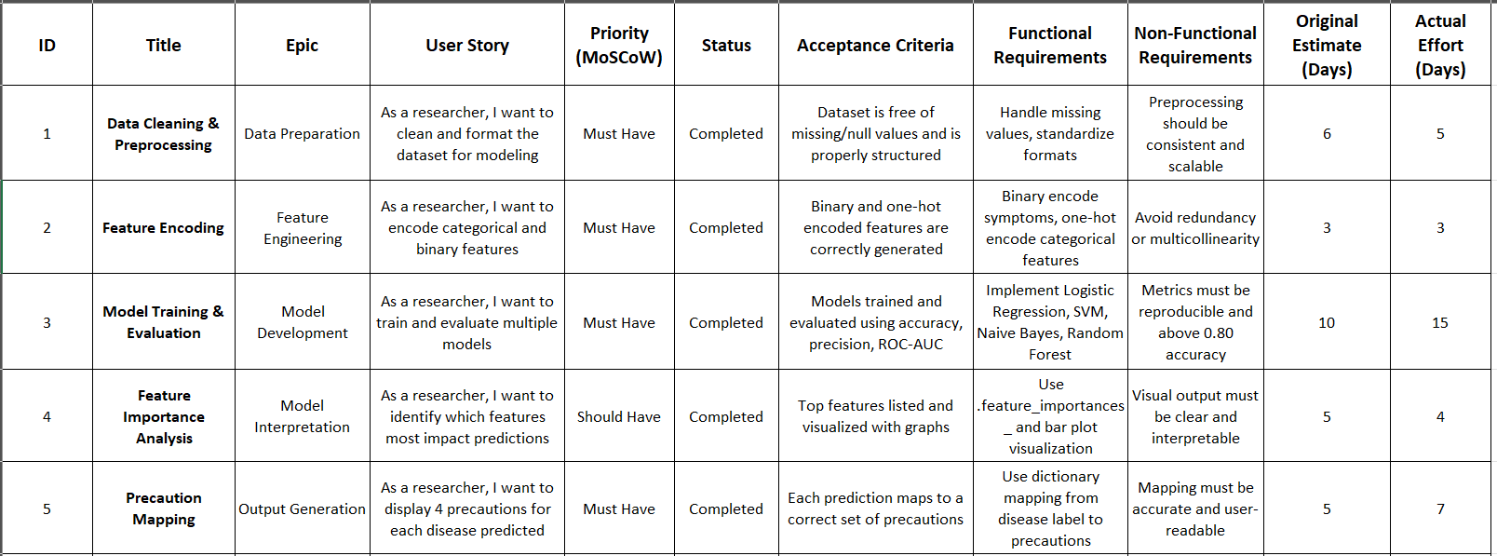
Product Backlogs- Researcher Perspective

Slide 8
Technique to implement the objectives
Data Collection and Preparation:
Created a custom dataset manually containing 116 diseases, associated symptoms, and precautions.
Collected patient-related features like age, gender, blood pressure, and cholesterol levels.
Data Preprocessing:
Handled missing values using appropriate imputation techniques.
Converted key symptoms (e.g., fever, cough, fatigue, breathing difficulty) into binary format.
Applied one-hot encoding for categorical variables such as gender, blood pressure, and cholesterol level.
Normalized or encoded data where required to make it suitable for machine learning models.
Model Development and Training:
Split the dataset into training (80%) and testing (20%) sets.
Implemented multiple classification algorithms:
Logistic Regression
Naive Bayes

Slide 9
Support Vector Machine (SVM)
Random Forest Classifier
Used libraries such as scikit-learn for model implementation and evaluation.
Model Evaluation:
Assessed models using key performance metrics:
Accuracy
Precision
ROC-AUC Score
Confusion Matrix
Classification Report
Plotted ROC curves to visually compare model performance.
Feature Importance Analysis:
Used Random Forest’s built-in feature importance scores to rank the most influential features in disease prediction.
Visualized feature importance using bar plots.
Precaution Mapping:
Associated four static precautions with each disease to offer basic health guidance alongside prediction results.

Slide 10
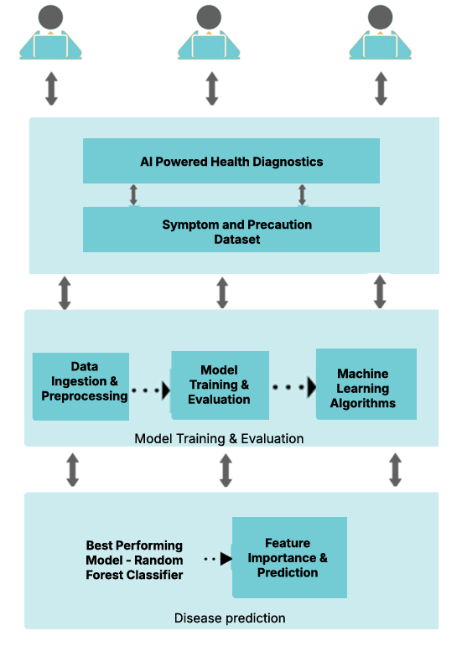
System Architecture

Slide 11
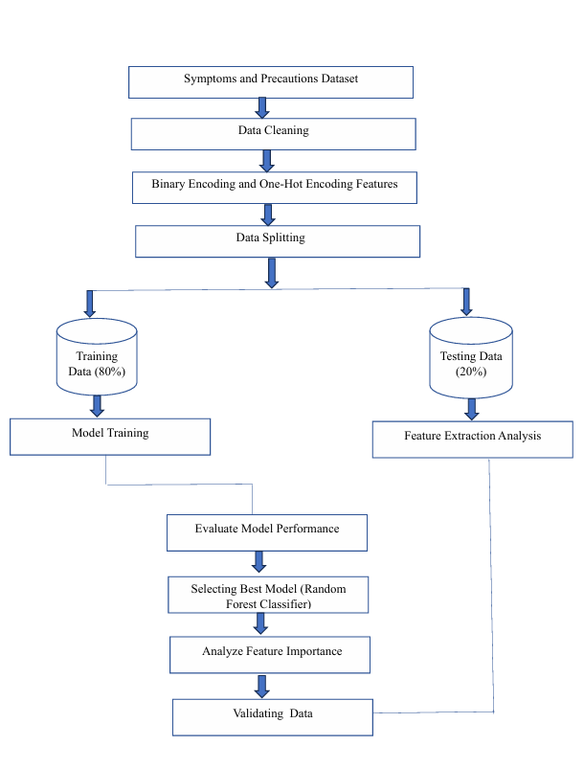
Flow/Block Diagram

Slide 12
Project SDG
This project aligns with UN Sustainable Development Goal (SDG) 3: Good Health and Well-Being by promoting early disease detection and preventive healthcare. It supports:
SDG 3.4 – Reducing premature mortality from non-communicable diseases through early diagnosis and intervention.
SDG 3.8 – Enhancing accessibility to essential healthcare services via a scalable, AI-driven health assessment system.
SDG 3.D – Strengthening early warning and risk reduction through machine learning-based disease prediction.

Slide 13
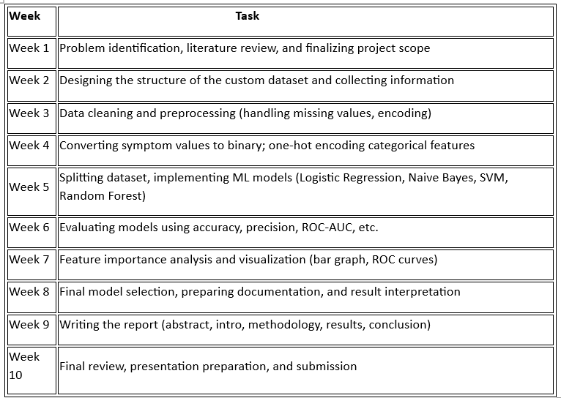
Plan of Action (Timeline)

Slide 14
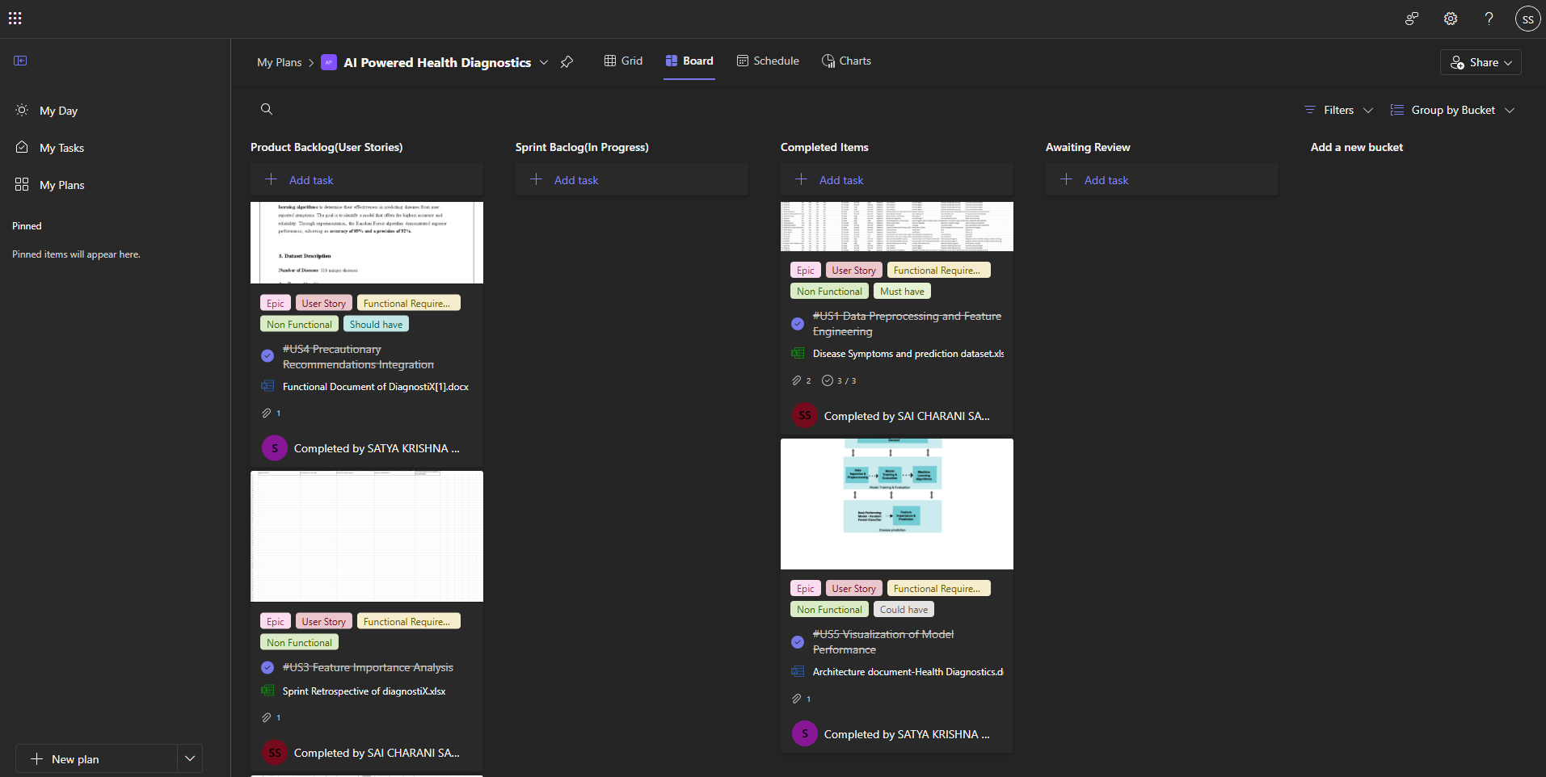
MS Planner

Slide 15
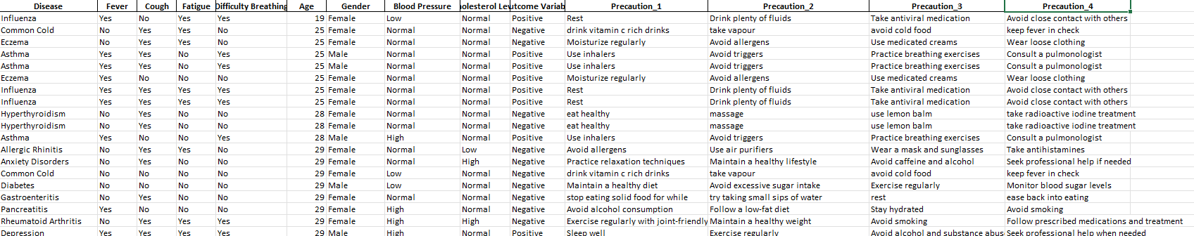
Results and Discussions

Slide 16
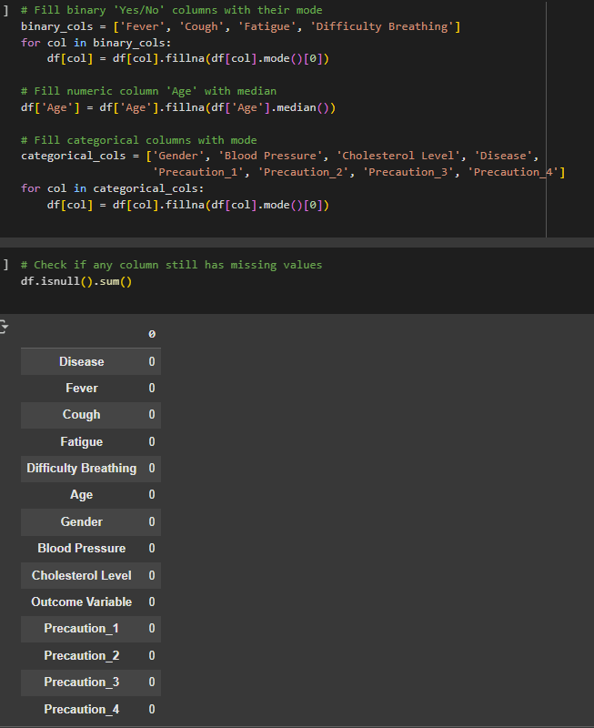
Handling the Missing Values

Slide 17
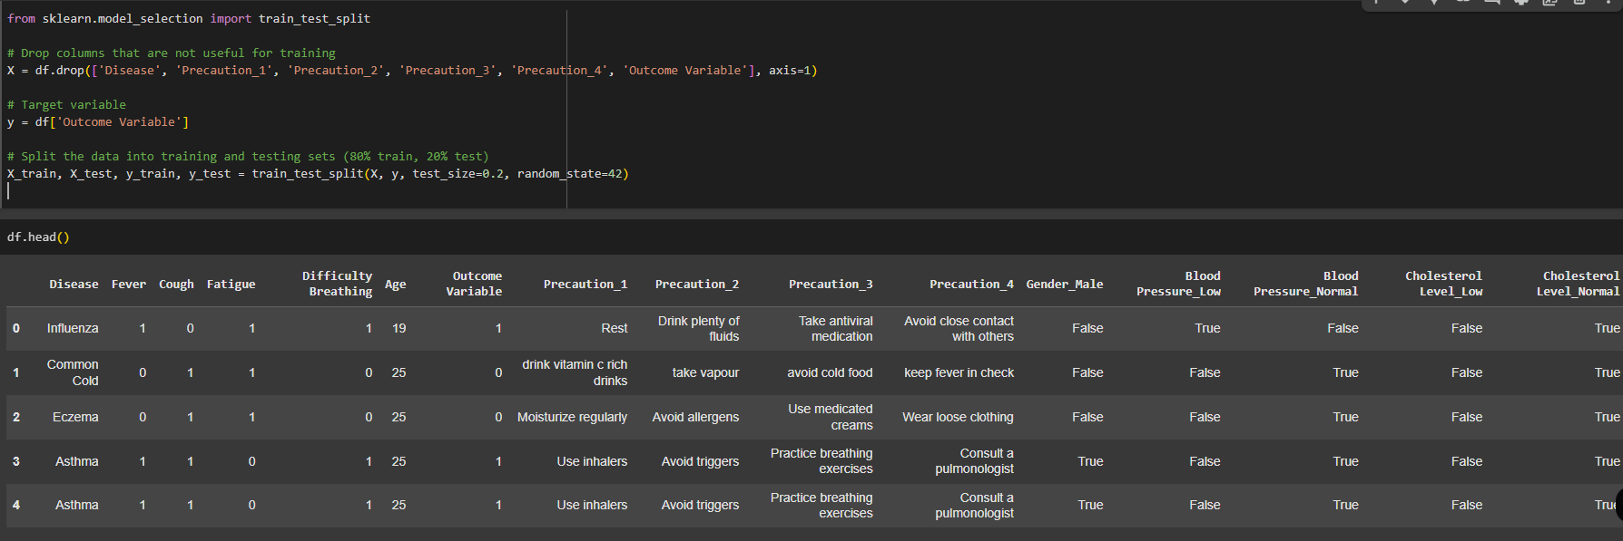
Training the Data

Slide 18
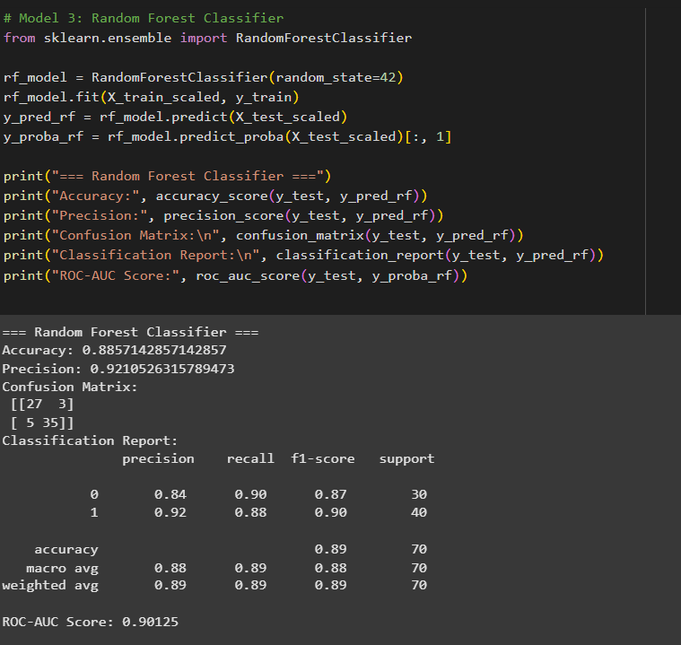
Random Forest Classifier

Slide 19
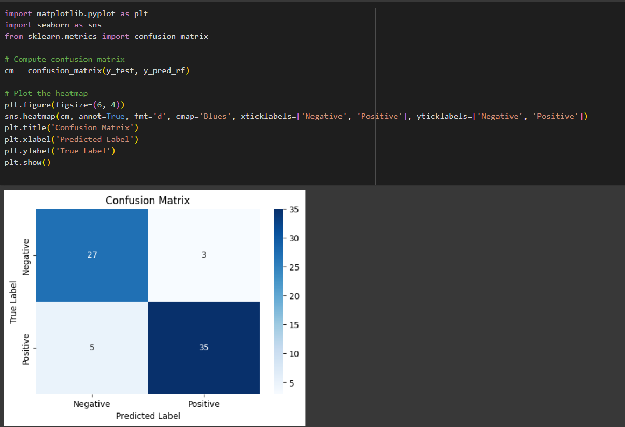
Confusion Matrix (Random Forest Classifier)

Slide 20
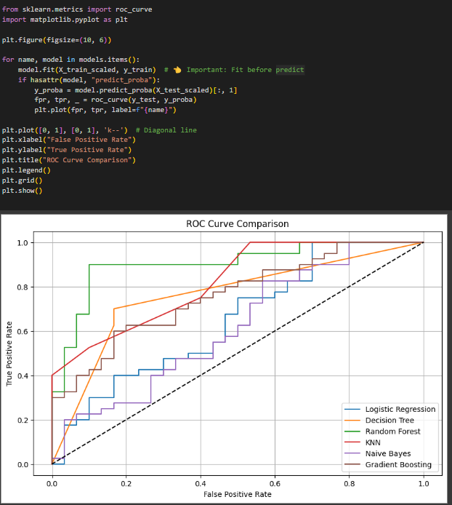
ROC Curve

Slide 21
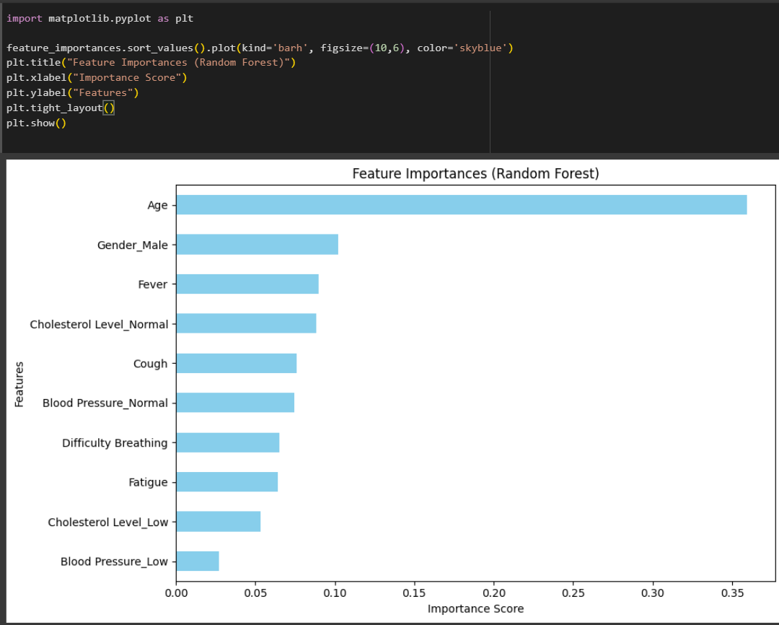
Feature Importance

Slide 22
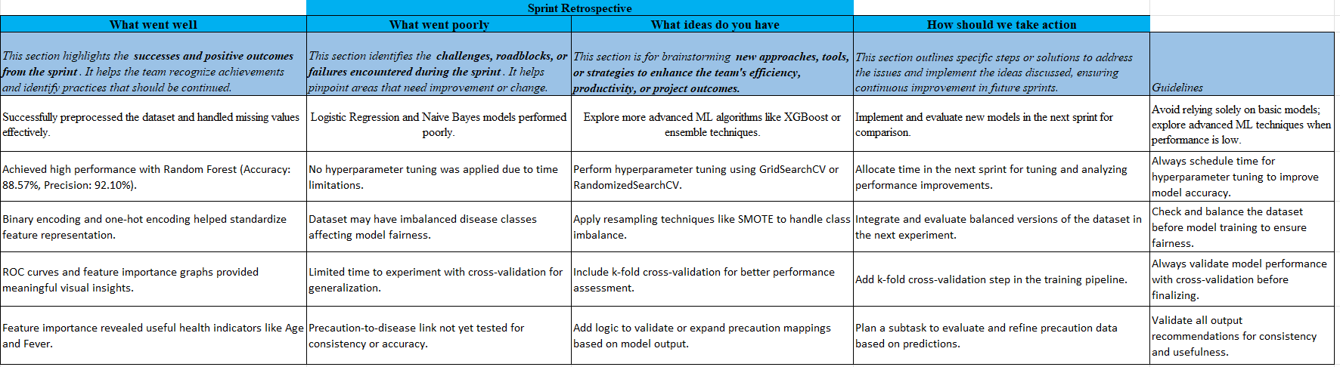
Sprint Retrospective

Slide 23
References
[1] B. Sahithya, G. Prasad M. S., B. Sahithi, M. Krishna K., A. C. Devarlla, and Y. T. R., "Empowering Healthcare with AI: Advancements in Medical Image Analysis, Electronic Health Records Analysis, and AI-Driven Chatbots," 2024 3rd Int. Conf. on Intelligent Cybernetics Technology & Applications (ICTA), 2024. [Online]. Available: https://ieeexplore.ieee.org/document/10511753
[2] M. A. Sayed et al., “Parkinson's Disease Detection through Vocal Biomarkers and Advanced Machine Learning Algorithms,” arXiv preprint arXiv:2311.05435, 2023. [Online]. Available: https://arxiv.org/abs/2311.05435
[3] I. Gupta, V. Sharma, S. Kaur, and A. K. Singh, “PCA-RF: An Efficient Parkinson's Disease Prediction Model based on Random Forest Classification,” arXiv preprint arXiv:2203.11287, 2022. [Online]. Available: https://arxiv.org/abs/2203.11287
[4] Junhak Lee, Chungwhan Hwang, Jaehyun Park, and Tae Rim Park, “Explainable AI-Based Clinical Decision Support System for Disease Diagnosis,” 2024 International Conference on Artificial Intelligence in Information and Communication (ICAIIC). [Online]. Available: https://ieeexplore.ieee.org/document/10621550

Slide 24
Thank You

